Slide 1
CHAPTER 2

Slide 2
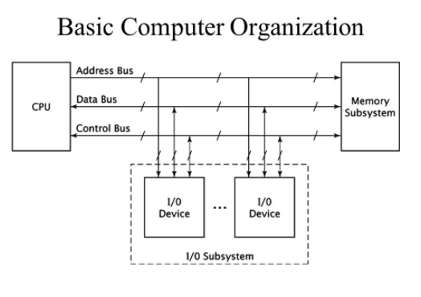
Basic Computer Organization

Slide 3
Contd..
This organization has 3 sub systems: CPU, memory sub-system and I/O sub-system.
CPU performs various operations and controls the computer.
Memory sub-system is used to store programs being executed by the CPU along with the necessary data.
The I/O sub-system allows the CPU to interact with input and output devices such as keyboards, monitors, etc.

Slide 4
System Bus A bus is basically a collection of wires, chips and slots inside the computer through which data and signals can be transmitted to and fro between the computer and peripherals.
Data Bus: =>provides path for moving data between the microprocessor and the peripherals. =>The data bus consists of number of separate lines, generally 8, 16, 32 or 64. The number of lines is referred to as width of data bus. =>Since, each line carries only 1 bit at a time, the number of lines determine how many bits can be transmitted at a time. =>bidirectional, Microprocessor can read data from memory or write data to the memory.
Address bus: =>provides path for address. =>For eg: if the CPU requires reading a word (8, 16, 32 or 64 bits of data) from memory, it puts the address of desired word on the address bus. => Unidirectional because the microprocessor is addressing a specific memory location. No outside devices can not write into Microprocessor. => also used to address I/O ports.

Slide 5
Contd…
Control bus: =>used to control the access and use of data and address lines. =>carry control and synchronization signals from CPU to peripherals and also do the same from peripherals to CPU. =>bidirectional Some of the control signals are: - memory read - memory write - I/O read - I/O write - bus request - bus grant - Interrupt request - Interrupt acknowledge

Slide 6
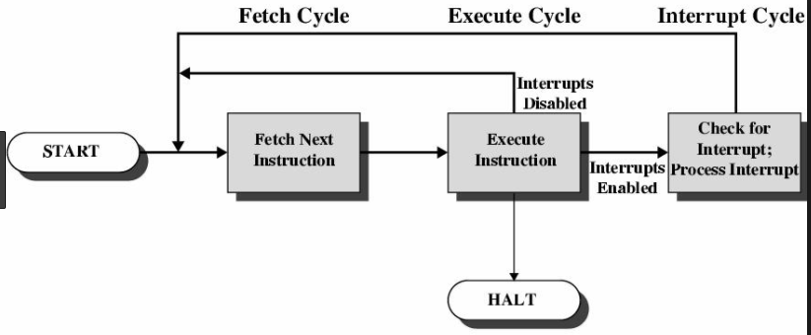
Instruction cycle

Slide 7
Contd..
The instruction cycle is the procedure a microprocessor goes through to process an instruction.
First, microprocessor fetches or reads instructions from memory. (microprocessor outputs address of instruction on the address bus) =>The register PC holds the address of next instruction to be fetched. Before the CPU outputs the address onto the address bus, it retrieves the address from PC. =>Memory sub-system inputs this address and places the corresponding instruction into system data bus. =>The CPU, then reads the instruction code from the system data bus.
Then, it decodes the instruction determining which instruction it has fetched.
Finally, it performs the operation necessary to execute the instruction.
Each of these functions i.e. fetch, decode and execute consist of a sequence of one or more operations.

Slide 8
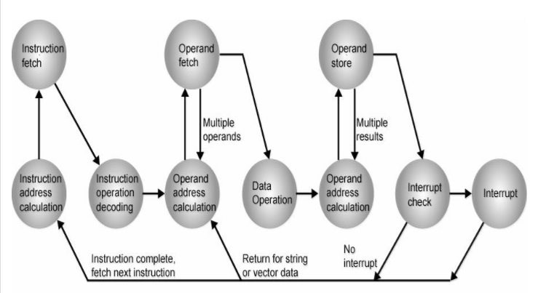
Contd…(instruction cycle state diagram)

Slide 9
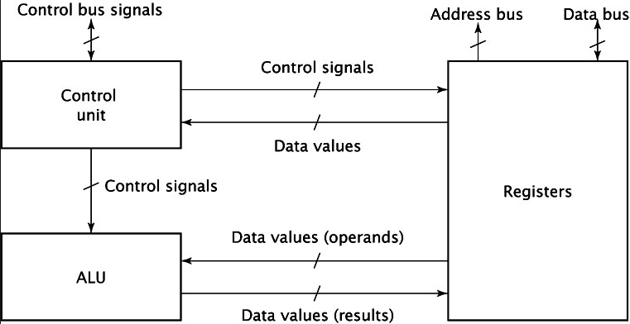
CPU organization

Slide 10
Contd…
The register section includes the set of register and a bus(or other communication mechanism). It also contains other register which are not accessible directly by the programmer.
ALU performs the arithmetic and logical operation which obtains its operand from the register section and stores the result back to it. =>Since, the ALU must complete its operation within a single clock cycle, it is constructed using only combinational circuit.
The control unit generates the internal control signal that causes the register to load data, increment or clear content, output content, causes ALU to perform correct function. =>also generate signal for the system control bus such as READ, WRITE, IO/M(bar) signal.

Slide 11
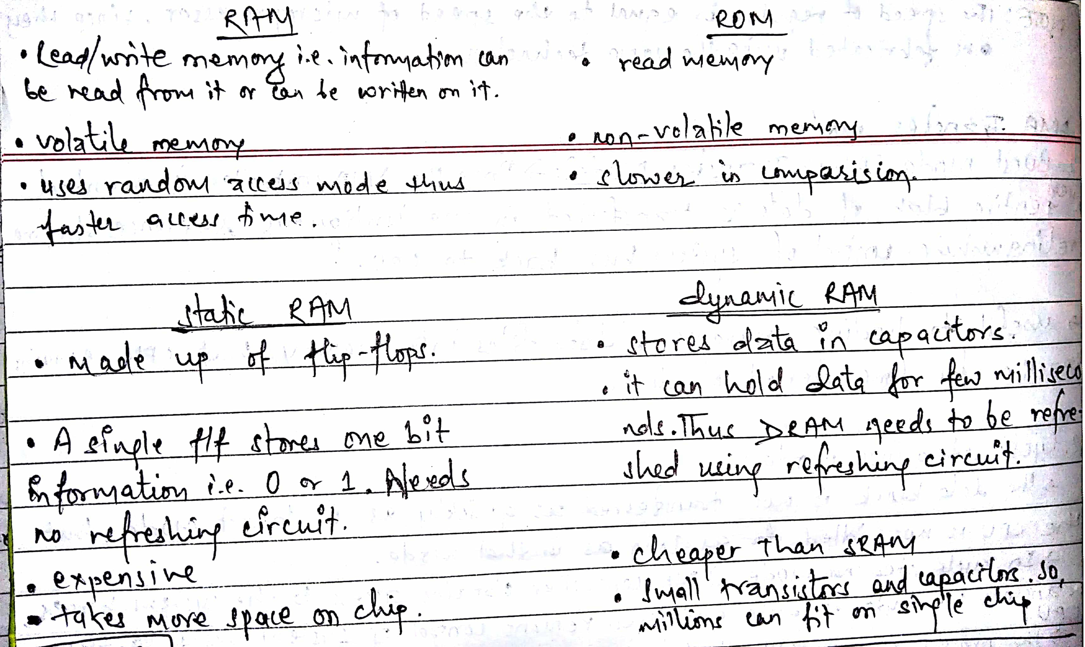
Memory Subsystem Organization and Interfacing:
Types of memory chips:

Slide 12
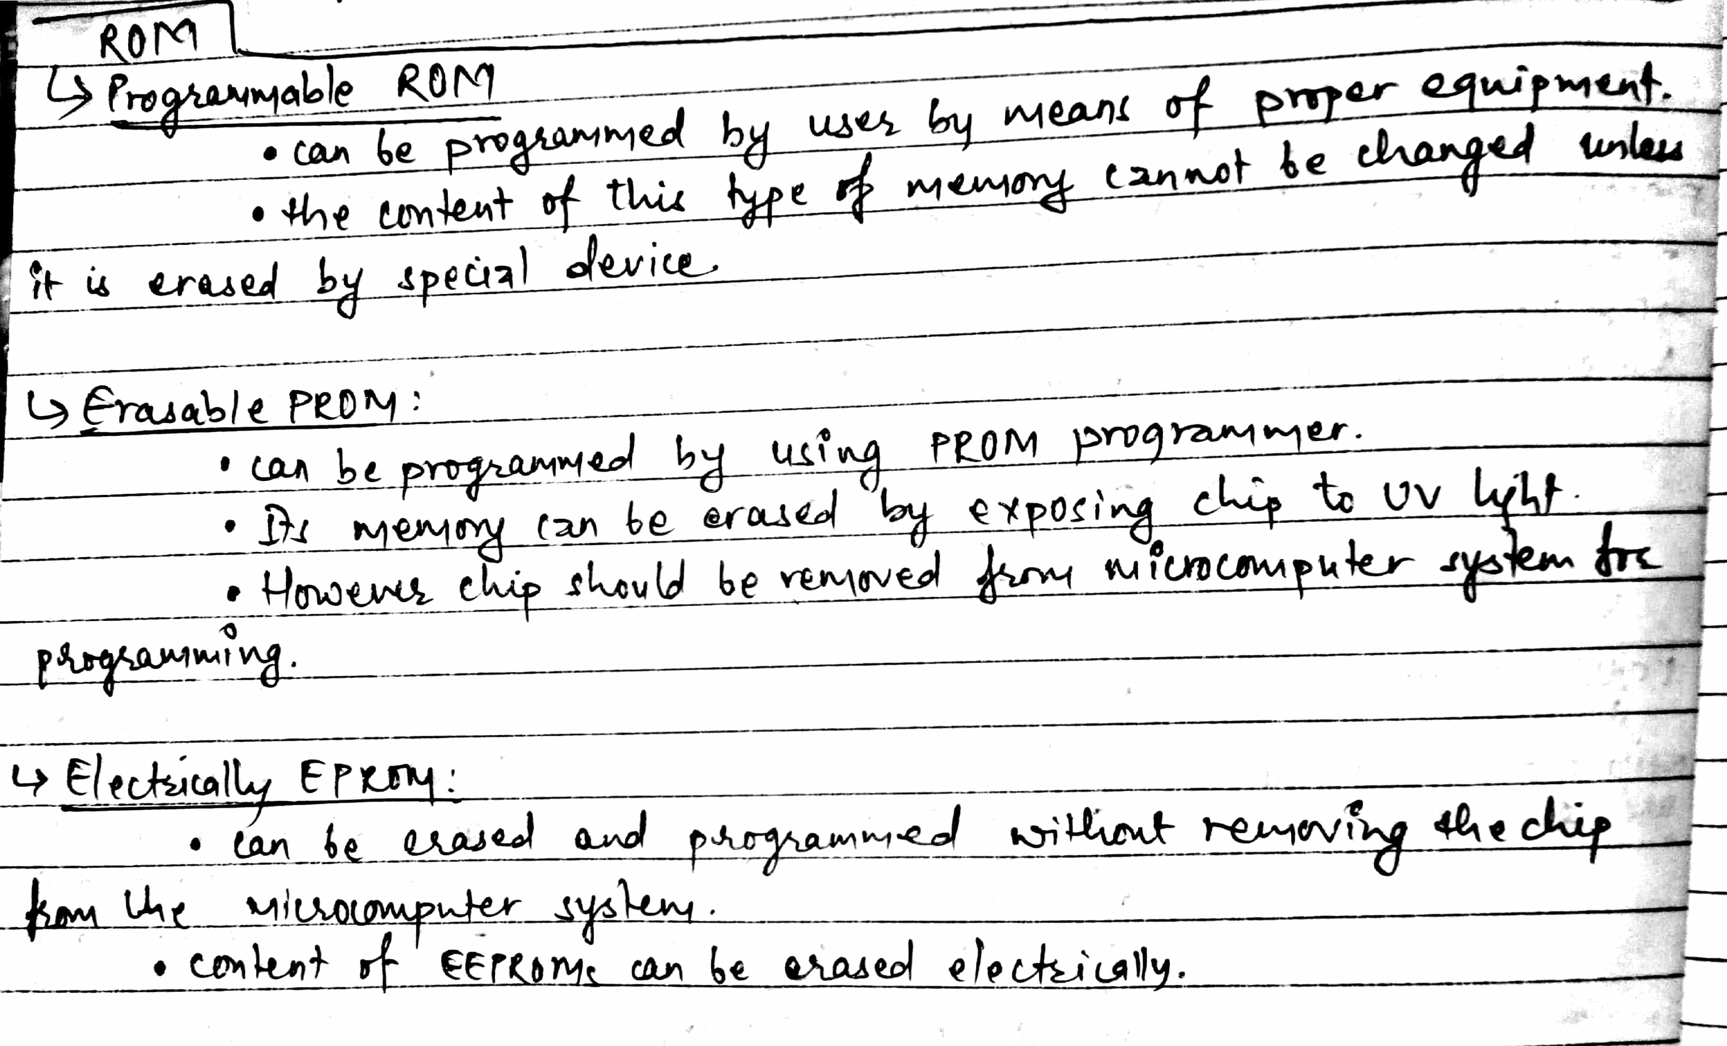
Contd…

Slide 13
Internal Chip Organization:
Consider an 8 x 2 ROM chip: =>Address line = 3 =>Data lines = 2 =>16 bits of internal storage
If CE = 0, decoder is disabled and no location is selected.
If CE = 1and OE= 1,tri-state buffer for that location cell is enabled and data is output from the chip.

Slide 14
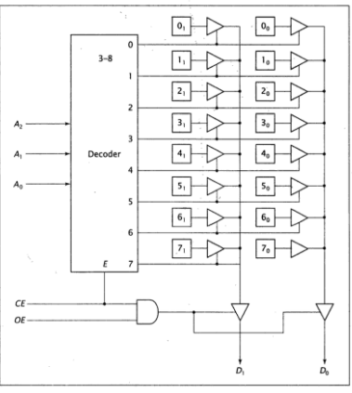
Contd..

Slide 15
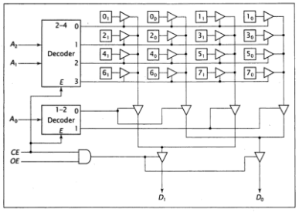
As the number of locations increases, the size of address decoder needed, becomes extremely large. To remedy this problem, the memory chip can be designed using multiple dimension of decoding. Consider two dimensional organization of the same 8 x 2 ROM chip:

Slide 16
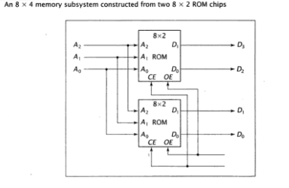
Contd..

Slide 17
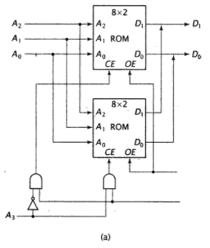
Construct a 16 x 2 memory subsystem from two 8 x 2 ROM chips with: a. high-order interleaving and b. low-order interleaving

Slide 18
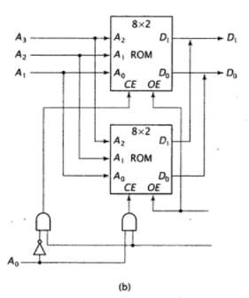
Contd…

Slide 19
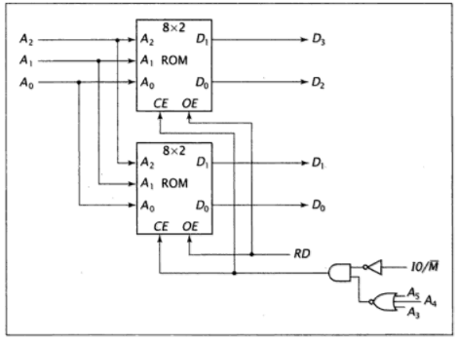
Construct a 8 x 4 memory subsystem from two 8 x 2 ROM chips with control signals. =>Assume system with 6-bit address bus =>A_{2,} A₁, A₀ select location within memory chips. =>A₅, A₄, A₃ must be 000 for the chips to be active =>RD or RD’ drives OE =>IO/M(bar) signal supplied by processors that use isolated I/O

Slide 20
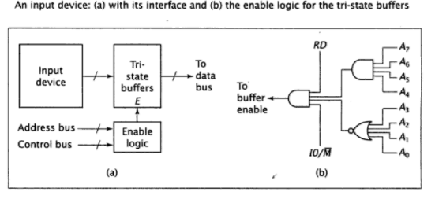
I/O subsystem organization and Interfacing

Slide 21
Contd..
The data from the input device goes to the tri-state buffer.
When the values on the address bus and control bus are correct, the buffers are enabled and data passes onto the data bus.
The CPU, then can read these data.
The key to this design is the enable logic. =>For the input device, the read signal (RD) should be asserted. =>Figure (b) shows the enable logic for an input device at address 11110000 with 8-bit address and control signals RD and IO/Memory(I0/M(bar))

Slide 22
Contd…
For the interface circuit for an output device, the tri-state buffer is replaced by a register.
The tri-state buffers are used in input device interface to make sure that no more than one device writes data to the bus at any time.
Since, the o/p devices read data from the bus, they do not need buffers so that data can be made available to all output devices.

Slide 23
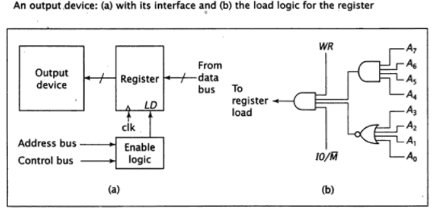
Contd…

Slide 24
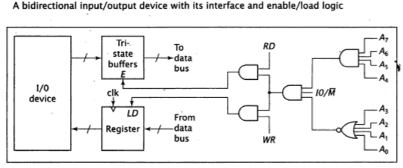
Contd…

Slide 25
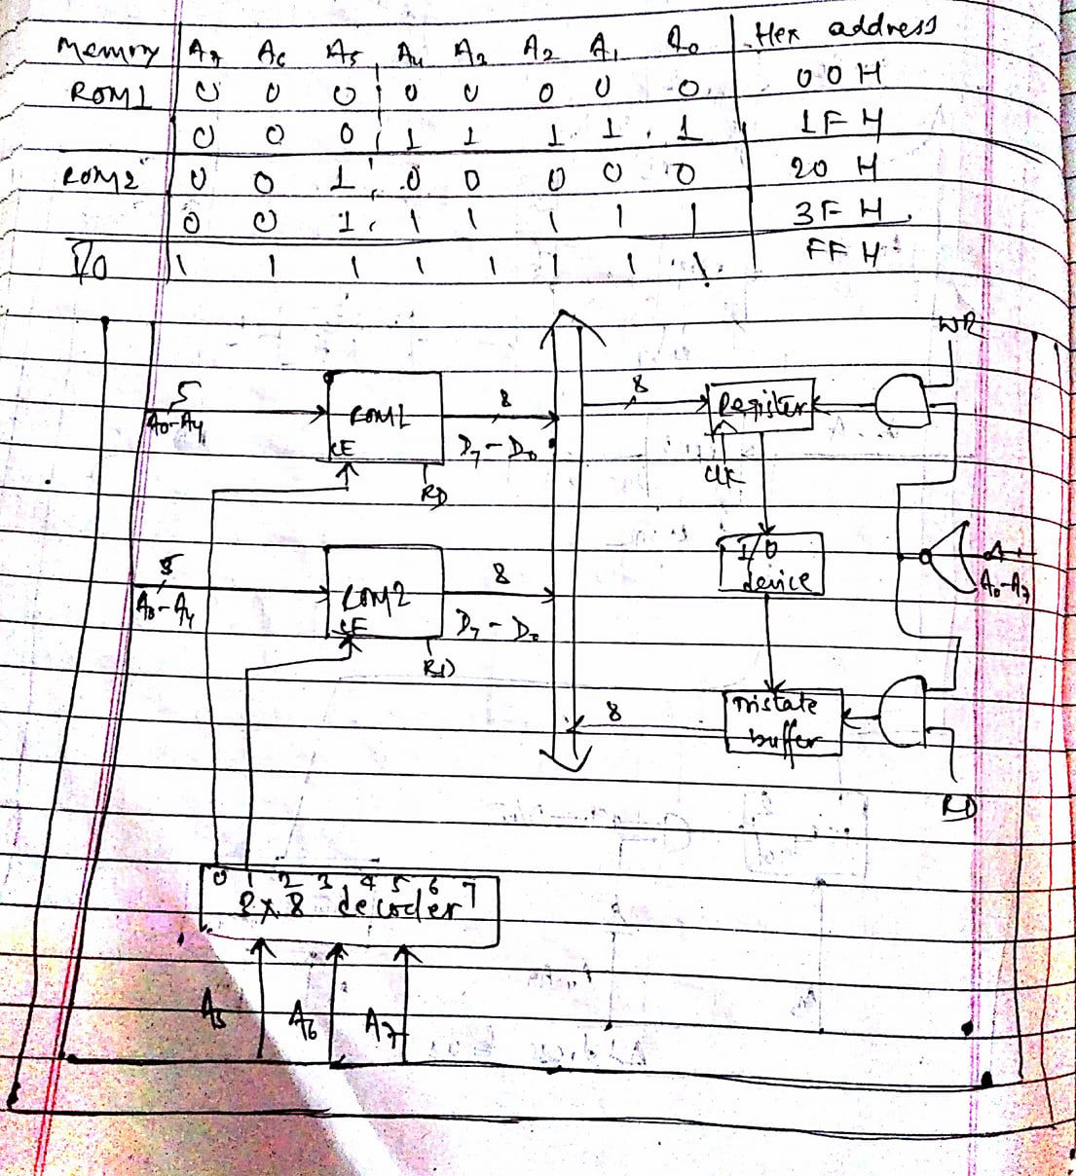
A CPU with 8-bit data bus and 8-bit address bus uses memory mapped I/O. It has 32 byte of ROM at 00H and 32 byte of ROM at 20H. It also has an I/O device at FFH. Show the load logic and enable logic.

Slide 26
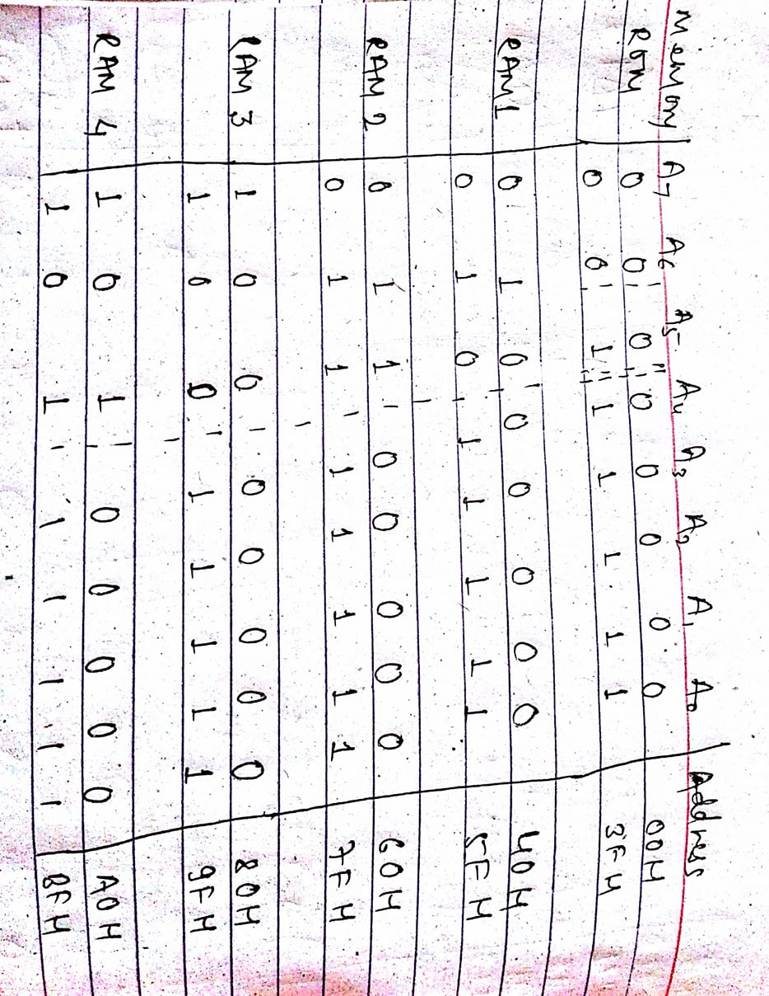
Computer with 8-bit data bus and 8-bit control bus uses isolated I/O. It has 64 bytes of ROM starting at 00H constructed using 64 x 4 chips; 128 bytes of RAM, starting at address 40H constructed using 32 x 8 chips; an input device with Ready at address 40H and output with an ready at 80H.

Slide 27
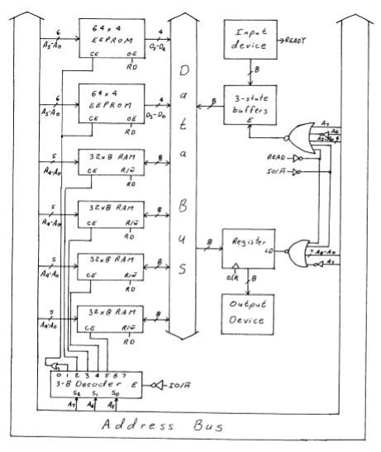
Contd..

Slide 28
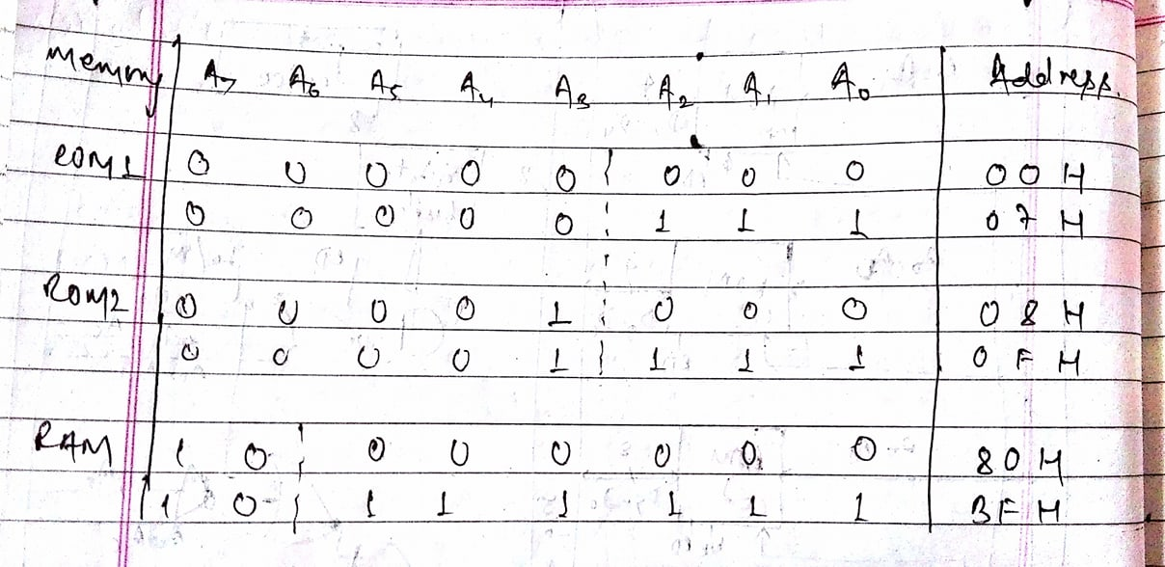
A computer system with an 8-bit address and an 8-bit data bus using isolated I/O. It has 16 x 8 ROM starting at address 00H constructed using 8 x8 chips; 64 x 8 of RAM starting at address 80H constructed using 64 x 4 chips. There is an I/O device at 40H. Show the design for the system.

Slide 29
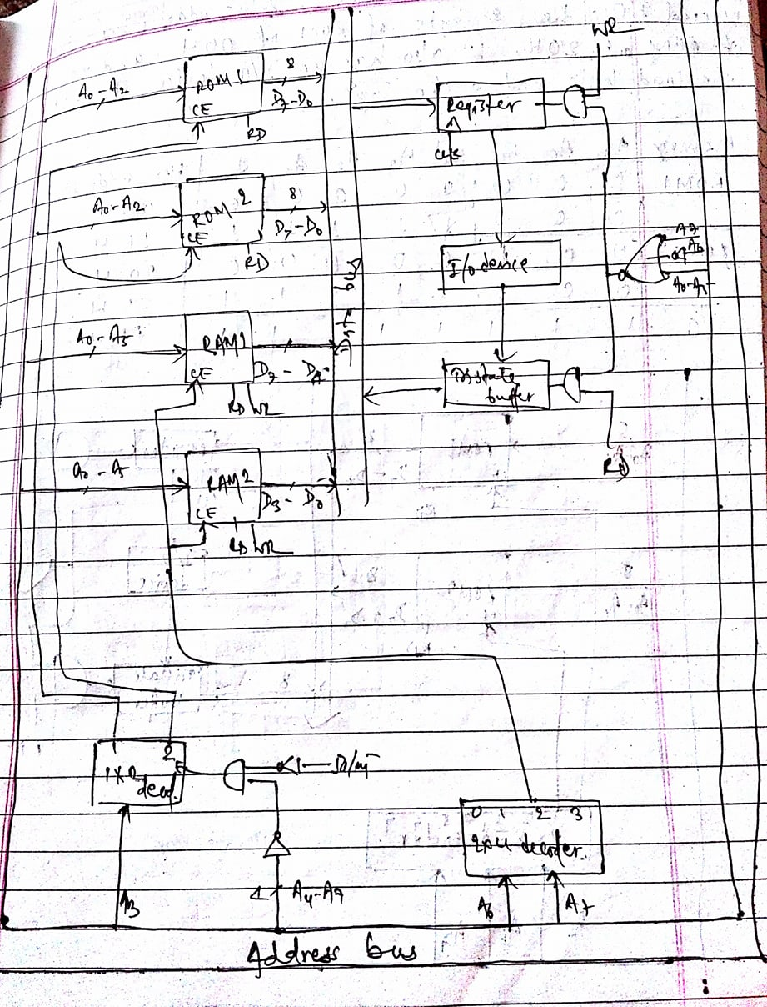
Contd..

